Slide 1
INVESTMENT POLICIES AND BUSINESS ENVIRONMENT IN NIGERIA

Slide 2
Country Name:
Federal Republic of Nigeria
Government Type:
Federal Republic, 36 States and Federal Capital Territory which is the Capital, Abuja,
01

Slide 3
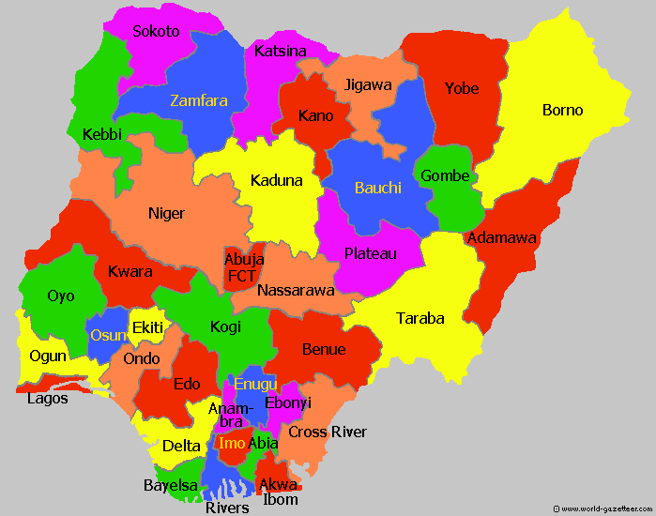

Slide 4
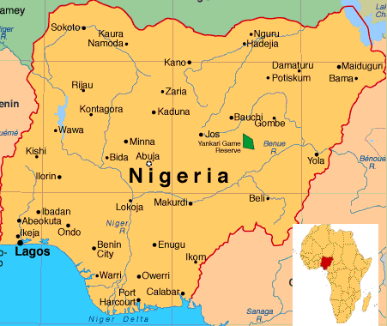
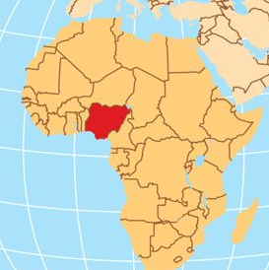
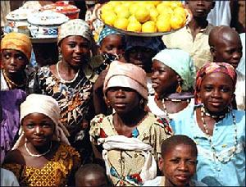
Location
Population
Size
Nigeria is located in West Africa on the Gulf of Guinea between Benin and Cameroon.
189 million (2016 est. ) and it is Africa's most populous country.
Nigeria has an area of 923,768 square kilometers,
including about 13,000 square kilometers of water.
02

Slide 5
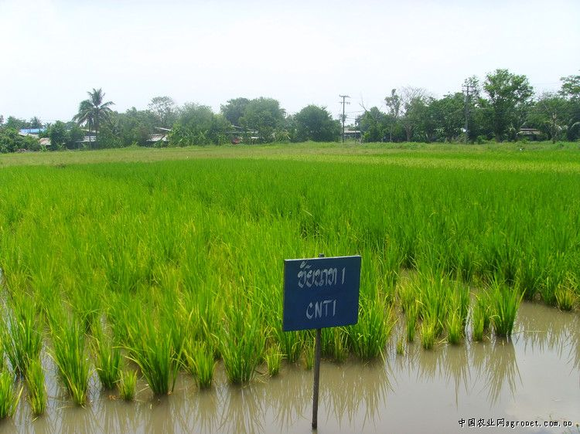
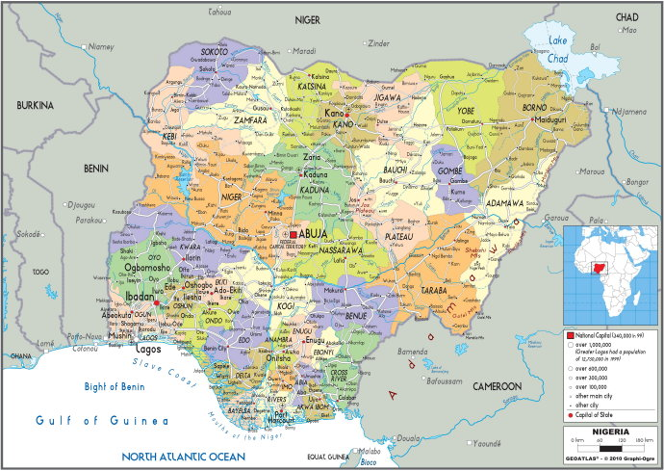
Land Boundaries
Land Use
Languages
Nigeria shares borders with Cameroon (1,690 kilometers) in the east, Chad (87 kilometers) in the northeast, Niger (1,497 kilometers) in the north, and Benin (773 kilometers) in the west.
.
Arable land: 33.02%
Permanent crops:3.14%
Others:
Irrigated land: 2,330sq.km
English (Official), Hausa, Yoruba and Igbo
03

Slide 6
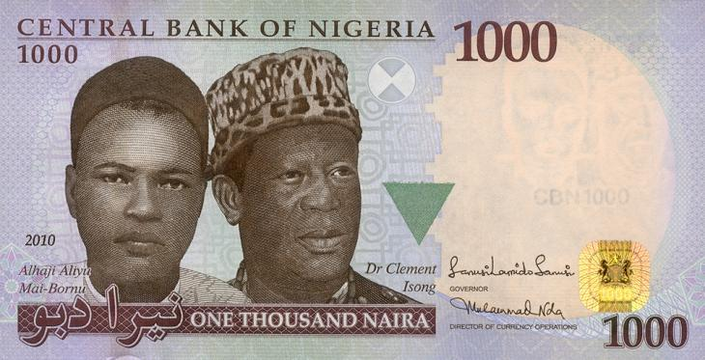
Economy
Sept2013
Currency: Naira
Exchanges: Naira(NGN)Per US Dollar- 305(official est.)
The Gross Domestic Product (GDP) is USD 413.7 billion (2017, estimate)
04

Slide 7
Nigeria is richly endowed with land and mineral resources
84 million hectares of arable land with 60% available for cultivation
44 exploitable minerals in proven commercial quantities
Largest producer of crude oil in Africa
9th largest gas reserves with 181 trillion cubic feet of proven reserve
Sokoto
Iron ore
Katsina
Jigawa
Zamfara
Yobe
Anambra
Benue
Delta
Kogi
Kebbi
Kano
Borno
Kaduna
Bauchi
Limestone
Niger
Gombe
Adamawa
Akwa Ibom
Anambra
Bayelsa
Borno
Cross-River
Plateau
Bitumen
Kwara
FCT
Ogun
Ondo
Edo
Nassarawa
Oyo
Taraba
Osun
Ekiti
Kogi
Ondo
Benue
Coal
Ogun
Enugu
Lagos
Edo
Anambra
Cross
River
Enugu
Plateau
Benue
Crude oil & Natural gas
Ebonyi
Delta
Imo
Abia
Delta
Rivers
Bayelsa
Akwa Ibom
Lagos
Bayelsa
Rivers
Akwa Ibom
Gold
Kaduna
Kebbi
Kwara

Slide 8
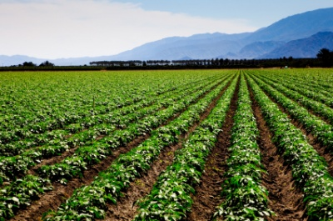
The Agricultural Sector
Overview
The agricultural sector plays a key role as Nigeria’s key growth driver
The sector is the second largest contributor to GDP (21% in 2015) and provides employment for over 70% of the population
Nigeria has some of the richest natural resources for agriculture production in the world
Abundant and reliable rainfall in over two thirds of the country
Opportunities
Nigeria is the most populous country in Africa and a fast-growing population will increase domestic consumption
A young and growing population provides a large pool of labour
Favourable climate, fertile land and water resources ideal for export-oriented production
84 million hectares of arable land, of which only 40% has been cultivated
Initiatives
New US$9 million equity fund from the African Development Bank for small and medium sized agribusinesses
Machines and equipment enjoy duty waivers
Capital allowance of up to 50% for plant and equipment

Slide 9
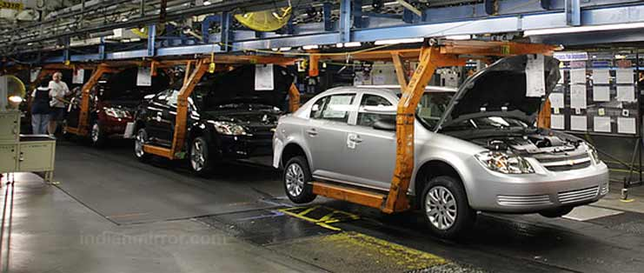
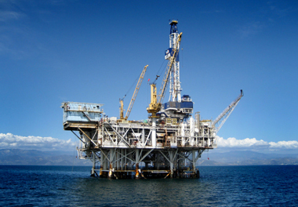
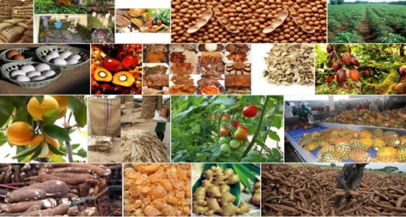
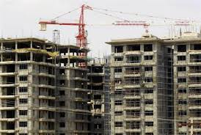
The Manufacturing Sector
Overview
Productivity in the manufacturing sector has continued to improve due to various intervention programmes by government
The sector’s average capacity utilization has grown from 35% in the 1990s to an average of 55% in the last three years.
The average contribution to GDP has grown to 10% in 2015
Lagos and its surroundings are home to about 60% of Nigeria’s industrial base. Other key industrial centres are Kano, Aba, Port Harcourt, Ibadan and Kaduna
Nigeria’s most important manufacturing sub-sectors include cement, food processing and fast moving consumer goods
Opportunities
Oil & Gas Related Industries
Petrochemicals
Fertilizer
Methanol
Refineries
Plastics
Construction and Light Manufacturing
Housing
Cotton, Textile and Garment
Electronics
ICT Equipment
Agro-allied and Agro Processing
Food Processing (Beverages, Packaged Foods, etc.)
Sugar Production
Palm Oil Processing
Leather and Leather Products
Rubber Products (Tyre)
Cocoa Processing
Metals and solid Minerals Product
Cement Production
Automobile Assembly
Basic Metal/Steel
Aluminium
Chemicals

Slide 10
Reasons to invest in Nigeria
Demographics
Description
1
Young & skilled workforce
Young and skilled workforce with 43% of the population under 15 years, improved labour productivity and over 1.8million new graduates every year
2
High urbanization rate & growing middle class
High urbanization rate with 48% of the population in urban areas and 168mn people forecasted to live in big cities by 2030. Rising consumer spend projected to increase by $94bn in 2025
Institutions
3
Vibrant financial systems
Robust financial markets with 7 of the top 25 banks in Africa and the second largest Stock Exchange on the continent
4
Improving business conditions
Implementation of a strategic plan to tackle short term macro-economic challenges. Active anti-corruption campaign and decline in casualties from security incidents.
Opportunities
5
Abundant land & natural resources
84mn hectares of arable land, 9th largest gas reserves and 44 exploitable minerals in proven commercial quantities
6
Largest market in Africa
Largest market in Africa with proximity to other west African markets. Land borders with Benin, Cameroon, Chad & Niger & 4 international airports
7
2nd biggest cluster of large companies
56 companies with revenues over $500mn and 2nd largest cluster of large companies in Africa
Investor friendly climate
Investor friendly climate with strong appetite to encourage private sector investments. Generous statutory incentives with 14 Free Trade Zones .
8

Slide 11
NIPC promotes and facilitates business investments to Nigeria
Strategic Roles
Established by the Nigerian Investment Promotion Commission Act 16 of 1995 to:
Promote, co-ordinate and monitor all investments in Nigeria
Initiate measures to enhance investment climate
Assist incoming and existing investors by providing support services
Collect and share information on investment opportunities and sources of capital
Services
Provision of investment information
Matchmaking investors with opportunities and partners
One-Stop Investment Centre
Connected to 27 agencies to facilitate investments and reduce time required to commence business operations
Provide assistance with company incorporation processes
Process regulatory approvals and permits
Support with issuance of visas on arrival
Administration / processing of Pioneer Status Incentive

Slide 12
National Investment Legislation
To ensure a sustainable and conducive business environment
Investment Promotion and Protection Agreement (IPPA)
Provides Equitable Treatment of investors –local and foreign
Make adequate provision for the Most Favoured Nation and National Treatment clauses
The NIPC Act
Allows foreigners to invest and participate in the operation of any Nigerian enterprise without restrictions
Allows 100% ownership assured except investments: listed under the ‘negative’ lists or covered by the Nigerian Content and Cabotage Acts
Protects against expropriation of investment: NIPC Act guarantees no enterprise shall be nationalized expropriated by any government of the Federation
The Foreign Exchange (Monitoring & Miscellaneous Provisions) Act 17 of 1995
Allows repatriation of Profit: investors are free to repatriate their profits and dividends net of taxes through any authorized dealer in freely convertible currency.

Slide 13
Several statutory incentives and sector specific incentives
Pioneer status: 3 - 5 years’ tax holiday
7 years’ tax holiday for pioneer industry sited in economically disadvantaged area
100% repatriation of profits allowed
Capital allowances:
Research & Development - 140% of expenses incurred
Investment in infrastructure - 20% of costs incurred
Raw materials utilization (60 - 70%) - tax credit of 20% for 5 years
Low Value Added Tax - 5%
Duty Waiver:
0% import duty & import value added tax for commercial aircrafts and spare parts imported for local use
0% import duty & import value added tax for machinery imported to develop solid mineral resources
0% duty for power generation and distribution machinery
Tax relief on interest income in the agriculture/agro-allied sector etc.

Slide 14
Thank you!
For more info please contact us:
Phone: +86 2085219782 Fax: +86 2085219963
Email: nigeria-guangzhoucg@hotmail.com
Go to our website!
(click here)
Address: Unit 902-03, 9th Floor, Grand Tower, Site 1of 228 Tian He Road, Tianhe District, Guangzhou 510620 China

